Slide 2
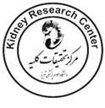
Initiating combination antihypertensive drug therapy

Slide 3
ACC/AHA hypertension guidelines
1) :normal ( < 120 systolic and < 80 mm Hg diastolic).
2): elevated (120–129 systolic and < 80 mm Hg diastolic).
3): stage 1 hypertension (130–139 systolic or 80–89 mm Hg diastolic).
4) : stage 2 hypertension ( ≥140 systolic or ≥90 mm Hg diastolic).

Slide 4
the following are 7 strategies recommended by the AHA/AMA (for ac- curate attainment of BP:
1): no conversation
2): empty bladder
3) :use correct cuff size
4): place BP cuff on bare arm
5): sup- port arm at heart level
6): keep legs uncrossed, and
7): support back and feet.

Slide 5
Importantly, though the diagnosis of hypertension has been confirmed at the 130/80 mm Hg threshold, most patients with stage 1 hypertension ( ∼69%) do not qualify for immediate drug therapy. The number of antihypertensive drugs to prescribe in drug naïve patients is guided by how far their BP is above target. In patients with BP > 20/10 mm Hg above tar- get, two-drug therapy, either as a single pill combination or two separate pills, should be initiated.

Slide 6
High-risk patients, those with diabetes, CKD (eGFR < 60 ml/min/1.73 m 2 and/or urine albumin: creatinine ratio ≥300 mg/g), post-renal transplantation, heart failure with reduced or preserved ejection fraction, known CVD, peripheral arterial disease, and/or ≥10% ten year ASCVD risk qualify, for antihypertensive drug therapy when BP is persistently ≥130 systolic and/or ≥80 mm Hg; the on treatment target BP is < 130/80 mm Hg.
J.M. Flack and B. Adekola / Trends in Cardiovascular Medicine 30 (2020) 160–164

Slide 7
Lower-risk patients (under 65 years of age), defined as those without the aforementioned high-risk co-morbidities and 10-year ASCVD risk < 10%, are recommended for antihypertensive drug therapy when BP is ≥140/90 mm Hg. Similar to most high-risk hypertensive, their target BP is < 130/80 mm Hg.
J.M. Flack and B. Adekola / Trends in Cardiovascular Medicine 30 (2020) 160–164

Slide 8
single agents at a standard dose achieve an average reduction of 9.1 mmHg which for many is insufficient to achieve control. Globally, the PURE study found that most participants being treated are on monotherapy (69.2%), and less than a third of those treated achieve blood pressure control < 140/90 mmHg
Curr Hypertens Rep (2020) 22:65

Slide 9
A meta-analysis of 42 trials involving nearly 11,000 participants showed that the effect of doubling the dose of an antihypertensive drug occasioned a reduction in systolic BP from 7.3 to 9.3 mmHg whereas the effect of adding a second drug averaged from 13.9 to 18.9 mmHg

Slide 10
Dose-response studies show that singly half-standard doses achieve approximately 80%of the efficacy of a standard dose with fewer adverse events for thiazides, beta-blockers, and calcium channel blockers and no difference for ACE inhibitors(ACE-I) and no adverse events in angiotensin II receptor blockers (ARB). Data from clinical studies and registries suggest that more than two-thirds of patients with hypertension require treatment with two or more antihypertensive drugs to achieve their target BP goals.
Curr Hypertens Rep (2020) 22:65

Slide 11
allocated to FDC therapy at baseline had better BP control at
6 and 12weeks compared with usual care, such that fewer patients
in the FDC arm required up titration of medications in the first place. Thus, even if use of FDC pills increased therapeutic inertia, the negative outcome was offset by the substantial upfront advantage in BP control.
JAMA Cardiology Published online July 22, 2020

Slide 12
103 consenting patients with type 2 diabetes, aged >40 years, with spot morning urinary albumin–creatinine ratio > 1000 mg/g (or > 500 mg/g in those on ACE inhibitor or ARB therapy at inclusion) were stratified by center and randomized to 4.5-year treatment with valsartan 320 mg/d (n = 36), benazepril 20 mg/d (n = 34) or halved doses of both medications (n = 33). The primary endpoint was end-stage renal disease (ESRD).
Diabetes Obes Metab. 2019;1–14.

Slide 13
Diabetes Obes Metab. 2019;1–14.

Slide 14
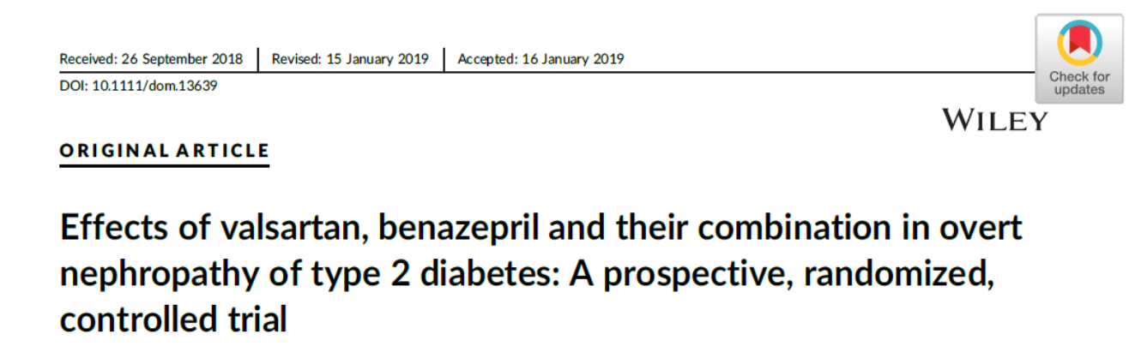
We found that 4.5 years of treatment with standard (manufacturer recommended)
anti-hypertensive doses of valsartan reduced the incidence of ESRD, the primary efficacy variable of the trial, more effectively than standard doses of benazepril or halved doses of both drugs in 103 participants with type 2 diabetes at high risk of fast renal disease progression because of renal insufficiency and overt proteinuria at inclusion, despite concomitant RAS inhibitor therapy.
Diabetes Obes Metab. 2019;1–14

Slide 15
Thus, consistent with the results of previous studies, the present data confirm:
that dual RAS blockade is not indicated in every day clinical practice , even when reduced doses of ACE inhibitors or ARBs are used

Slide 16
Patients who initiated antihypertensive medication with ACEI-thiazide diuretics combination therapy were less likely to add or switch therapies compared with their counterparts who initiated antihypertensive . monotherapy and more likely to achieve a BP goal of <130/80 mm Hg after 1 and 2 years of therapy

Slide 17
a systematic review and meta-analysis of randomized controlled trials (RCTs) published between January 1990 and January 2018 sourced via the PubMed, EMBASE, and Cochrane Library databases. 42 RCTs with 14,576 patients were included that investigated the efficacy and safety of dual blockade therapy compared with monotherapy in patients with DKD

Slide 18
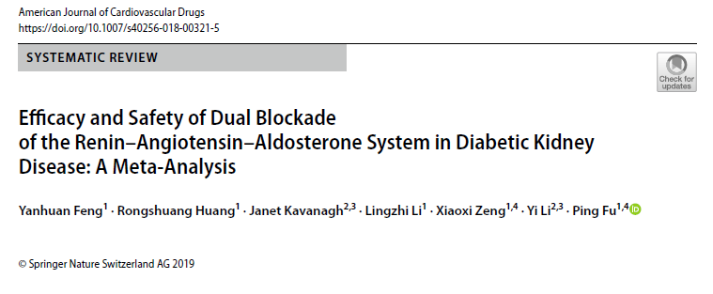
demonstrated that, in patients with DKD, a combination of RAAS inhibitors was superior to monotherapy in reducing urine protein and achieving goal BP. However, these advantages in short-term indices did not lead to improvements in prognostic outcomes ( ESRD, all-cause mortality, and cardiovascular mortality).

Slide 19
high-dose CCBs combined with ARBs controlled hypertension without elevation of serum uric acid level, although high-dose CCBs combined with ARBs and a triple combination with diuretics combined with standard-dose CCB/ARBs produced a similar efficacy in reducing the BP throughout the half year

Slide 20
The ACC/AHA guideline recommended thiazide diuretics as one of four acceptable first-line drug therapies with no preference between thiazide and thiazide-like diuretics in patients without selected co-morbidities that would alter this recommendation.

Slide 21
AHA on Resistant Hypertension recommended the use of thiazide-like diuretics, chlorthali done or indapamide, as preferred thiazide diuretics over HCTZ. Chlorthalidone has been compared to HCTZ directly and lowers BP more effectively , particularly at night, and has a much longer therapeutic half-life. Both chlorthalidone and indapamide have more CVD risk reduction data than HCTZ; thus, preferential use of thiazide-like diuretics in non-resistant hypertension also seems prudent.

Slide 22
LCZ696 (sacubitril/valsartan) is a first-in-class dual-action molecule of the neprilysin inhibitor sacubitril and the angiotensin II type 1 receptor blocker valsartan. LCZ696 has been approved by the FDA for heart failure treatment and awaits approval for hypertension because recent clinical studies had demonstrated that it is more effective than a monotherapy in lowering BP.

Slide 23
Sacubitril/valsartan is a single drug. It exerts its beneficial cardiovascular and BP lowering effects through its dual inhibition of RAS with valsartan and neprilysin with sacubitril. Neprilysin is an important catabolizing agent of the natriuretic peptides (NPs), which possess significant diuretic, natriuretic and vasodilating .The NPs are endogenous hormones released from the heart in response to wall stretching from pressure and volume overload and exert their beneficial cardiovascular and antihypertensive effects through plasma volume contraction and peripheral vasodilation.

